Slide 1
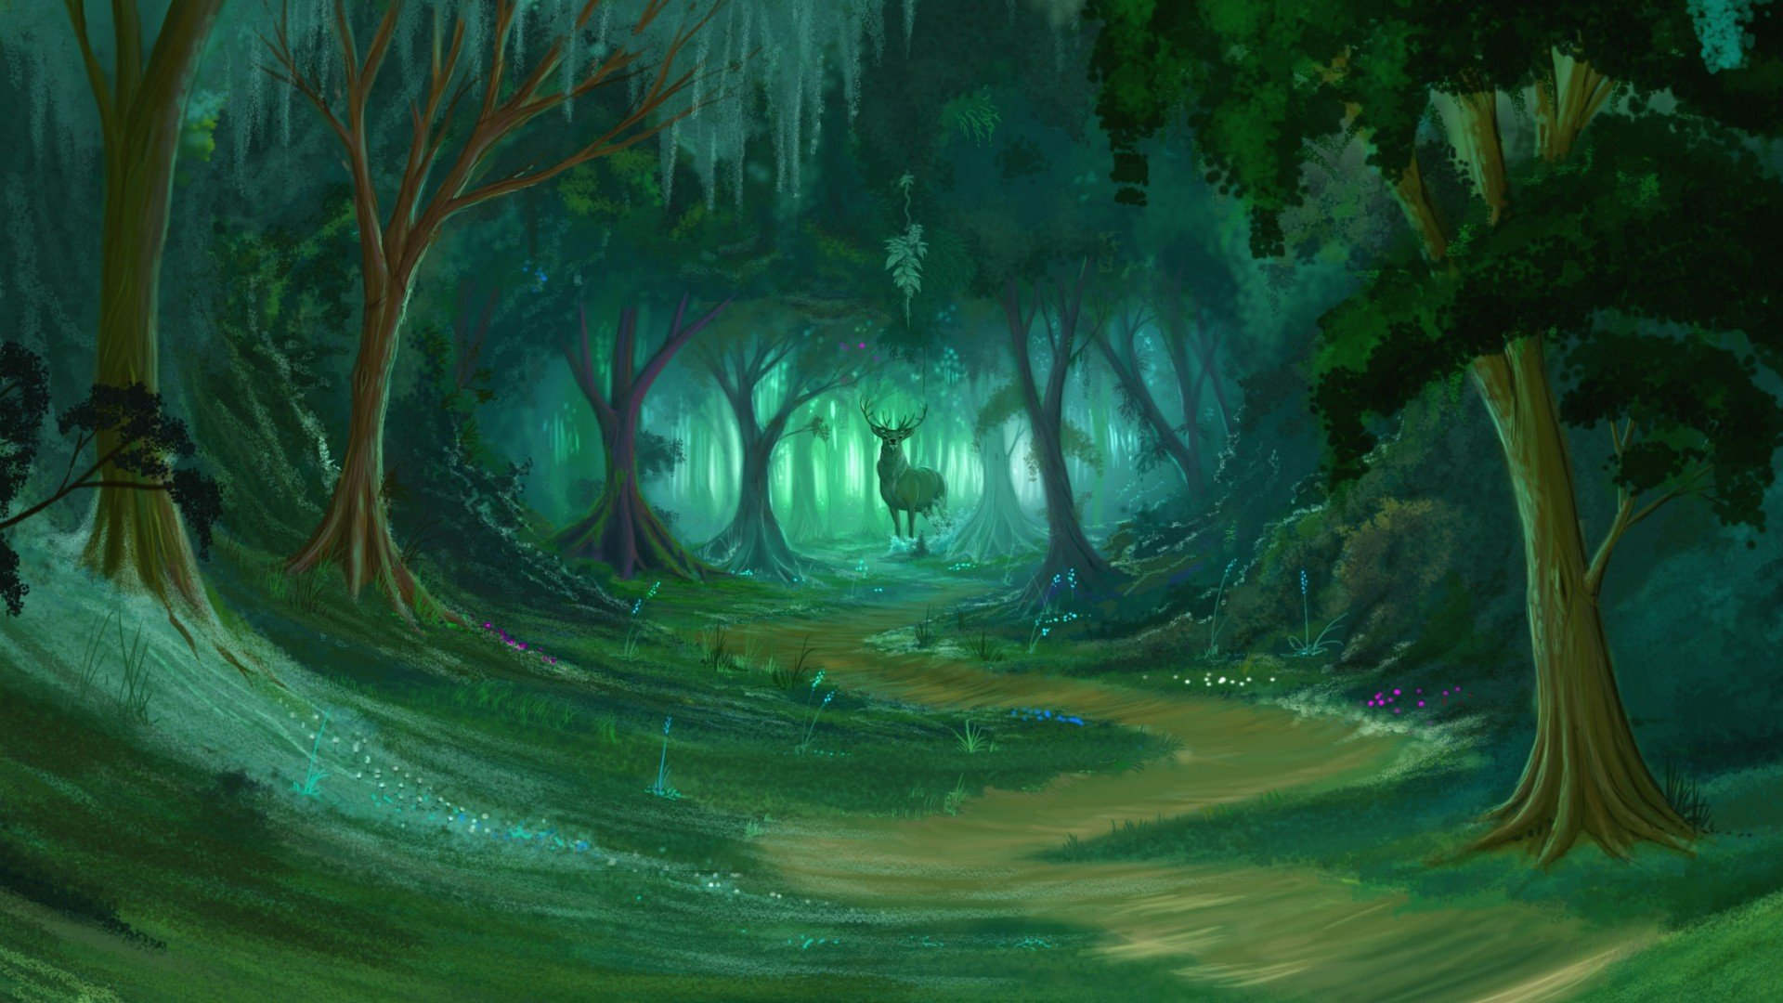

[enter]
Copyright @ 2018, J&Y Inc.
By:YifanXu,Julie Huang, Anna Huang

Slide 2




Slide 3

Story Line:
Long time ago, a hunter who named Alissa is trying to catch a youngest Squirtle(Evan) in order to let him work for the human, while she doing this, Evan’s friend and family stand out and trying to protect him. To win the game, Alissa must defeat them.

Slide 4



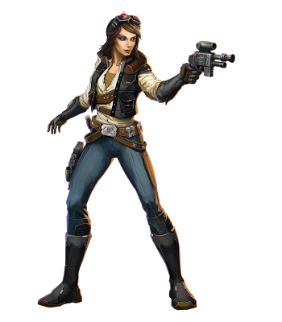





Level:1

Slide 5






Level:2

Slide 6




Slide 7

Thank you for watching and listening!!!

